Slide 1


Data Analysis

Slide 2


Today's agenda
Project recap
Problem
The Analytics team
Process
Insights
Summary

Slide 3

Social Buzz is a Social media & content creation company that emphasizes content by keeping all users anonymous, only tracking user reactions on every piece of content.
Due to their rapid growth and digital nature of their core product, the amount of data that they create, collect and must analyze is huge.
They hired Accenture for 3 month POC focusing on:
An audit of their big data practice
Recommendations for a successful IPO
An analysis of their content categories that highlights the top 5 categories with the largest aggregate popularity
Project Recap

Slide 4

Problem
100,000 posts per day
36,500,000 posts per year
How to find which category to invest in?
Analysis to find Social Buzz’s top 5 most popular categories of content

Slide 5



Andrew Fleming
Chief Technical Architect
The Analytics team
Marcus Rompton
Senior Principle
Devanshi Gangrade
Data Analyst

Slide 6
Process
1
Data Understanding
2
Data Cleaning
3
Data Modelling
4
Data Analysis
5
Uncover Insights

Slide 7

Insights
16
Unique Categories
1,897
#Reaction to Animal posts
May
Month with most posts

Slide 9
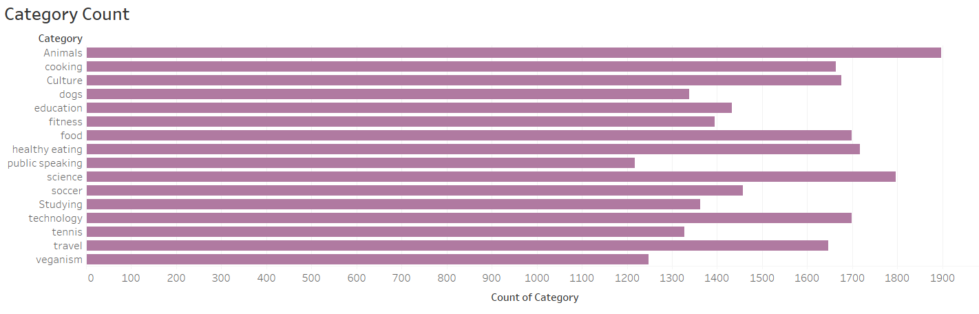

Slide 10
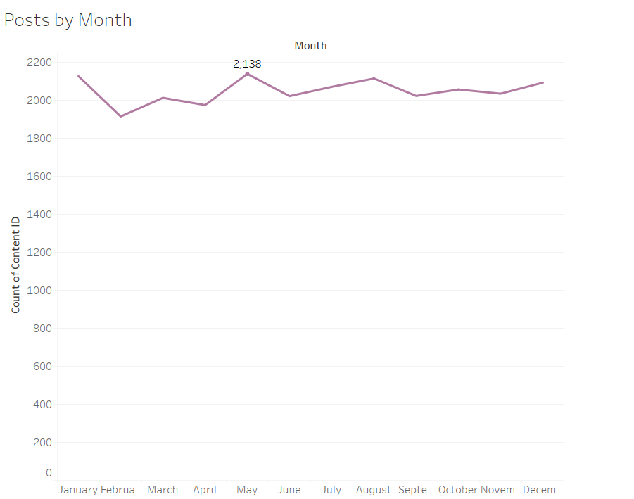

Slide 11

Analysis
“Animal” and “Science” are the most popular categories.
Food is among the top 5 categories, “healthy eating” and “food”, which indicates the type of audience.
Next Step
Focus can be put in these 5 categories to increase user engagement
Summary

Slide 12
Thank you!
ANY QUESTIONS?

